Slide 1
Instant Notice Motion Sensor
LED Strip Light
YI-CHEN CHEN
N11564628

Slide 2

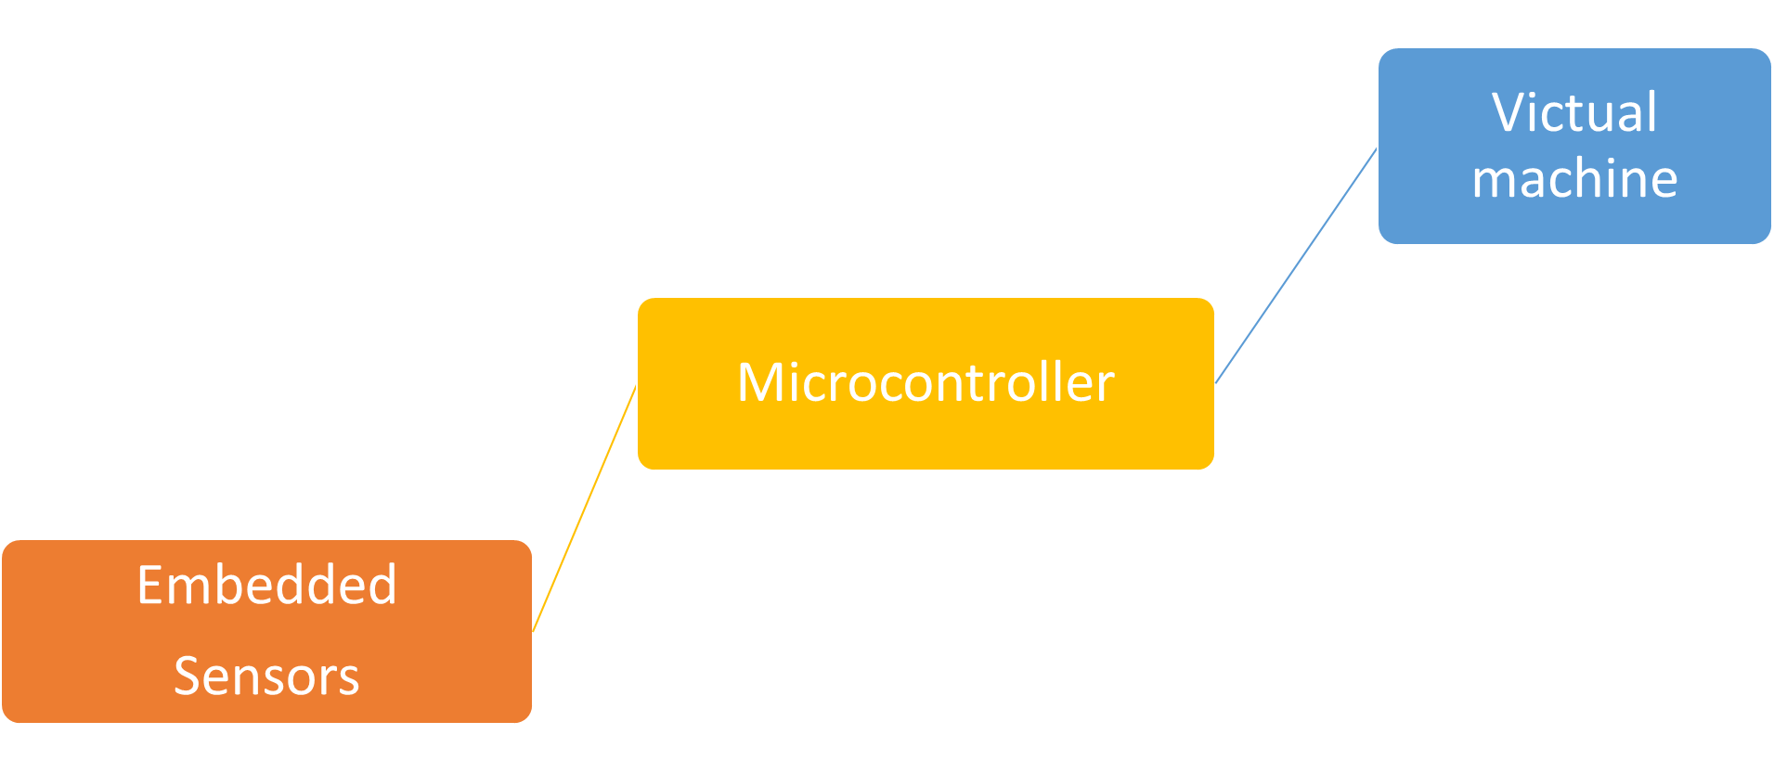
Project Overview

Slide 3
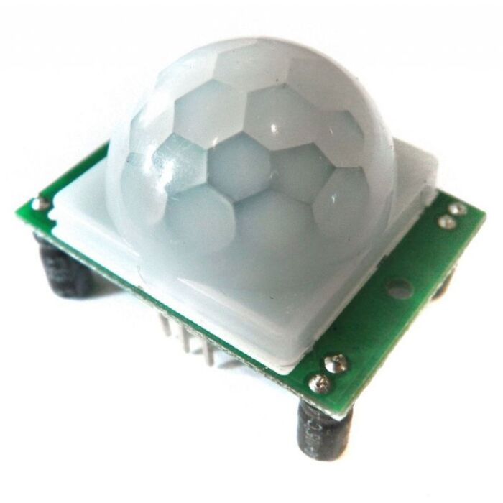
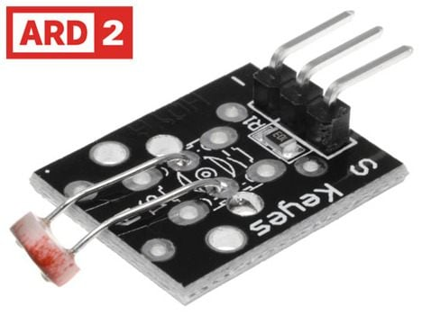
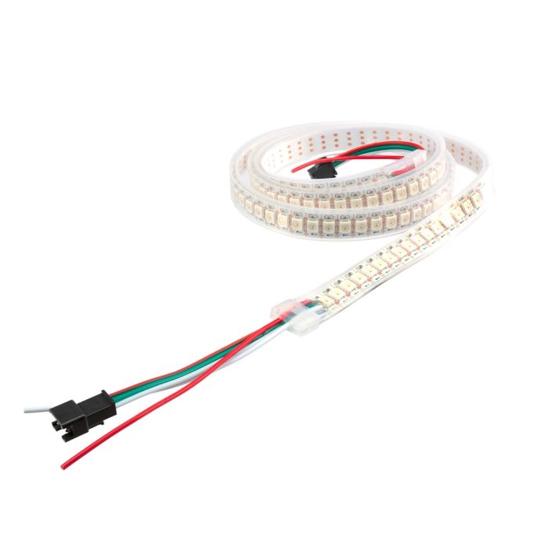
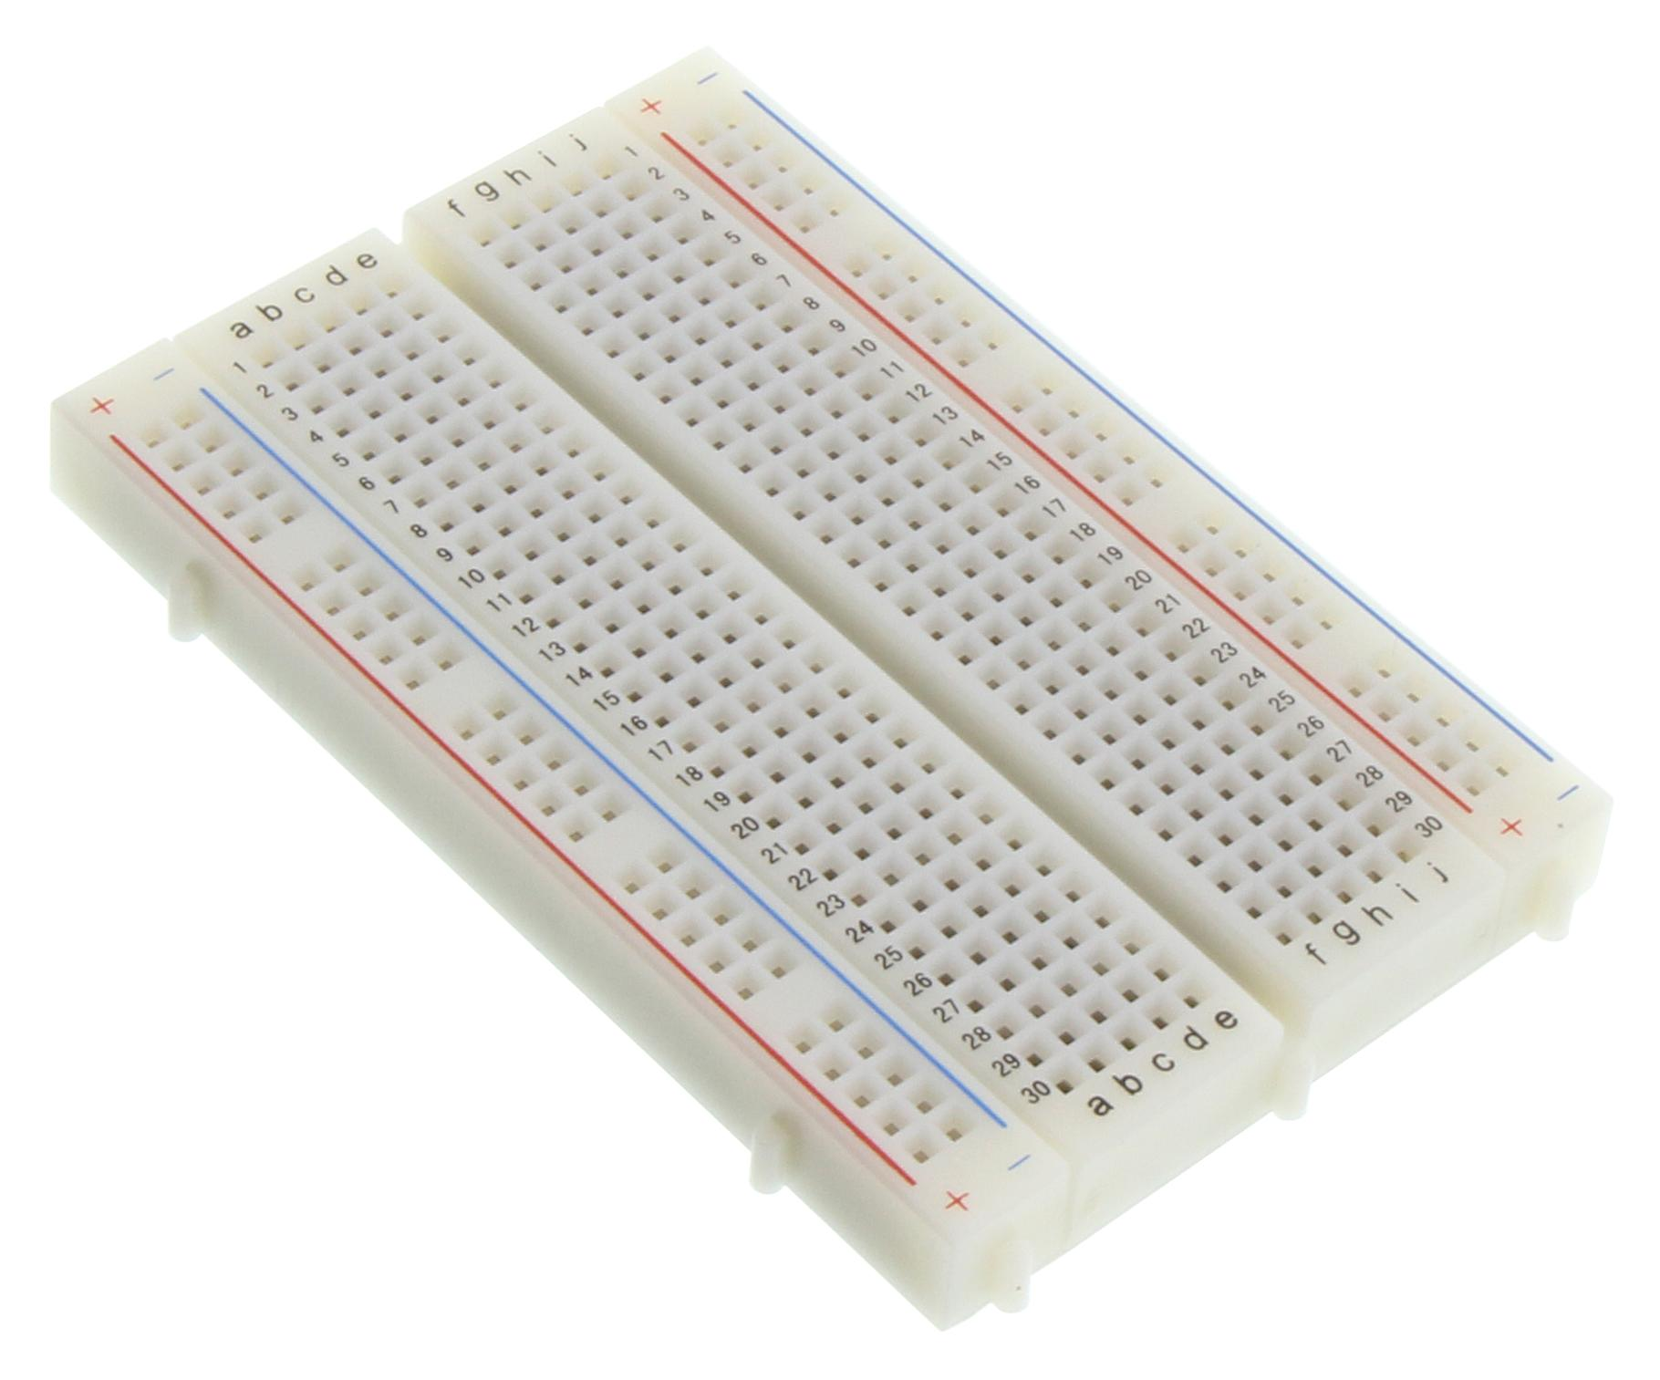
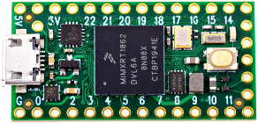
Tier 1 Design
PIR → Teensy
LDR → Teensy
Teensy → WS2812
LDR Light Sensor (ARD2-2218)
Passive Infrared (PIR) Motion Sensor
Bread board
Teensy board 2.0
WS2812b (RGB LED Strips)

Slide 4
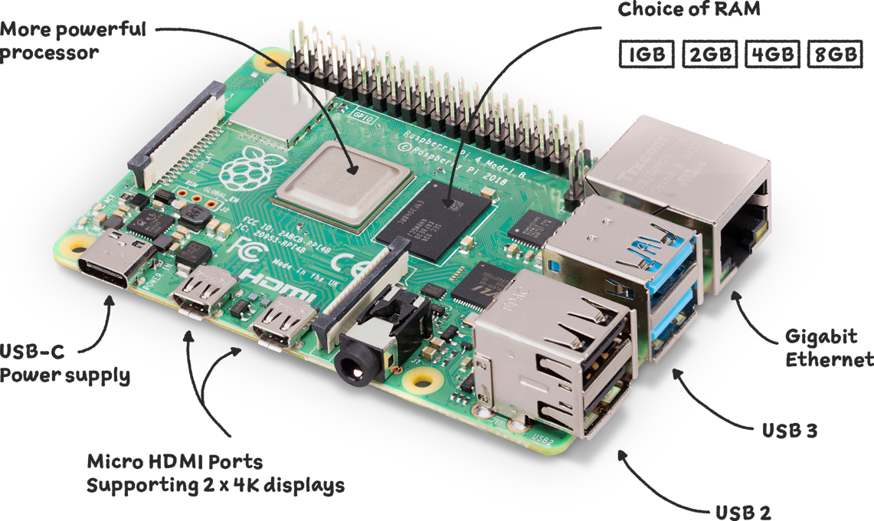





Tier 2 Design
Teensy → Raspberry Pi
Raspberry Pi → AWS EC2 (via MQTT)
Raspberry Pi → LED control

Slide 5





Tier 3 Design
MQTT Server
MQTT Client

Slide 6

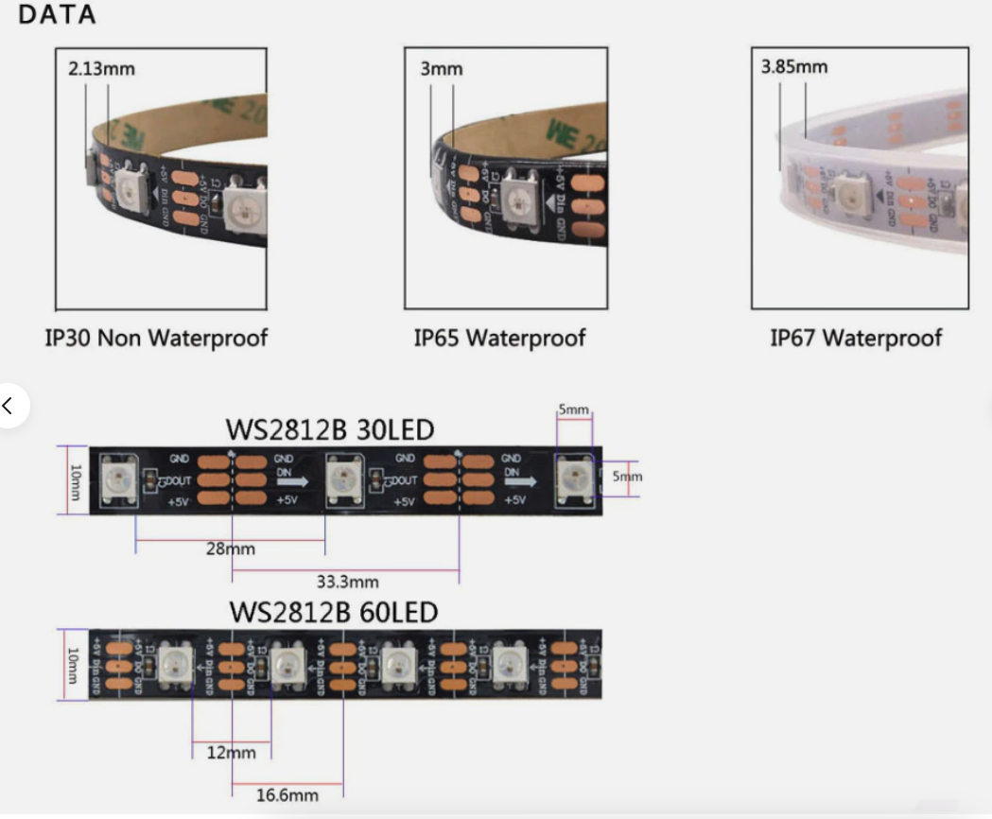

Design Considerations

Slide 7

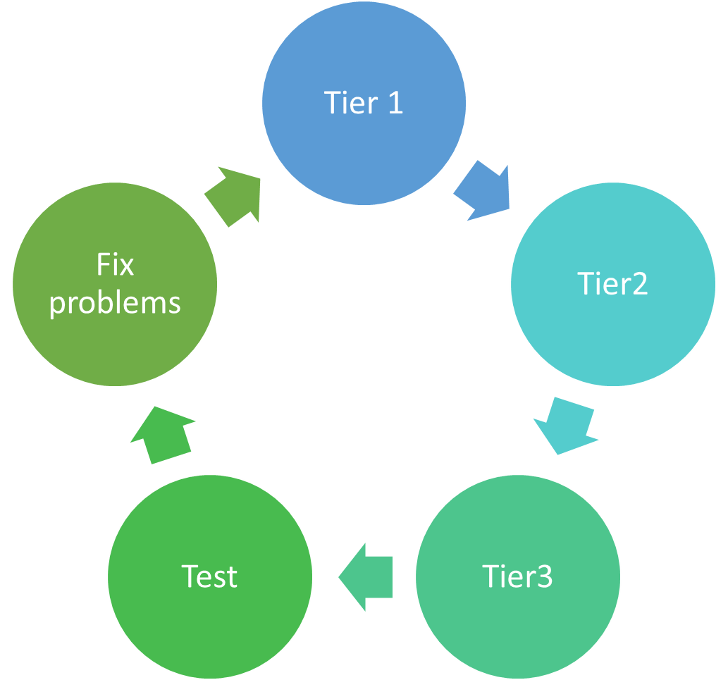

Methodology

Slide 8
Reference
Ramachandran, G., & Jurdak, R. (2023). IFN649 Advanced Networks Lecture Notes [PDF document]. Queensland University of Technology.
World Semi. (n.d.). WS2812 VS WS2812B. https://cdn.sparkfun.com/assets/learn_tutorials/1/0/5/WS2812B_VS_WS2812.pdf

